Slide 1
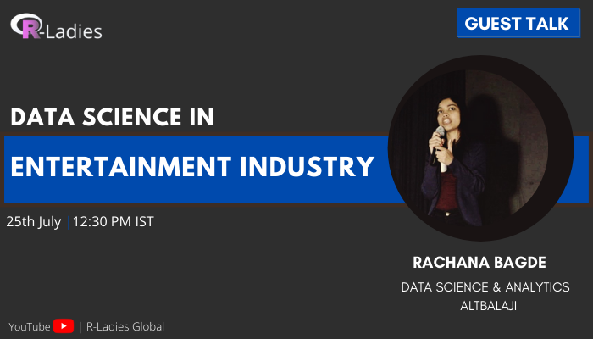

Slide 2

DATA SCIENCE
ENTERTAINMENT INDUSTRY (OTT)

Slide 3
WHAT TO EXPECT OUT OF THIS SESSION ?

Slide 4
APPROACH ?
BUSINESS FOCUSSED

Slide 5
Key Metrics
DAU, MAU
Subscriptions
Triggered Subscriptions
Watch Time
..a lot more, but this should be enough for now!

Slide 6
CHURN PREDICTION
Clustering to know the churning out audience in next 7 days is using which OS, what age group, how active he has been in his subscribed period, and what kind of shows he has watched.
Based on these information, personalized communications in form of Push Notifications, In-App Notifications, SMS, Whatsapp Communications, Emails, etc is made.

Slide 7
RECOMMENDATION
User based Recommendation where similarity is computed over the kind of content consumed.
If users have consumed similar kind of content, they will be cross recommended each other’s shows.

Slide 8
SUBSCRIPTION BEHAVIOUR
Clustering to understand what kind of different behaviour types we have when it comes to subscribing. Important Features like..
Based on how frequently user visits the platform, what is the content consumption rate, when exactly they subscribed gives us a fair idea of a subscription behaviour.
That helps in targeting the users more specifically based on the cluster they belong to.

Slide 9
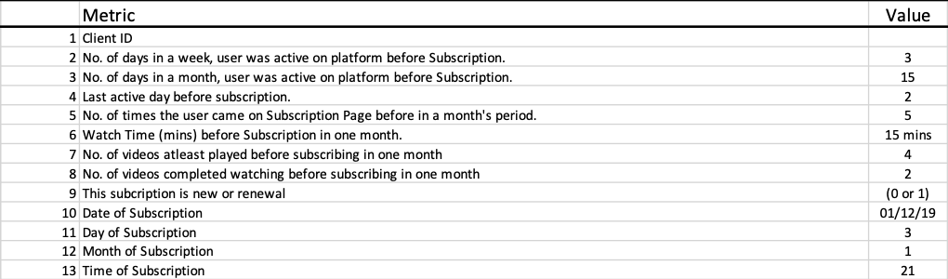

Slide 10
Questions ?

Slide 11
THANK YOU!
Rachana Bagde
linkedin.com/in/rachanabagde/

